Slide 1

MATOSHRI EDUCATION SOCIETY’S MATOSHRI COLLEGE OF ENGINEERING AND RESEARCH CENTRE,NASHIK
Department of Computer Engineering
Project Title: “Image Steganography using Least Significant Bit”
Presented By
Mr. Aditya Sonar, Mr. Samadhan Kardile
Mr. Ved Malve, Mr. Shashikant Kandekar
Group ID- 2305
Under the Guidance
Miss. Shilpa Adke

Slide 2

Table of Contents
Introduction
Literature Survey / Related Work
Motivation
Problem Statement
Project Objectives
System Architecture
Modules of Project
Description of modules
Design of Project
Prototype Model
References
Group ID : 2305

Slide 3
Introduction
In today's world, the need for Image Steganography has grown due to the increasing concerns about data privacy and security, as it allows for the covert transmission of sensitive information within digital images, making it a valuable tool for safeguarding confidential data.
Image Steganography is a technique that conceals information within images, providing a discreet way to protect sensitive data from unauthorized access or detection, making it increasingly relevant in today's data-driven and security-conscious landscape.

Slide 4
Literature Survey / Related Work
Author(s) | Title | Year | Journal/ Conference | Methodology
Fridreich et al. | Steganalysis of LSB Matching in Images | 2009 | Proceedings of SPIE – Media Forensics & Security | Investigated the Vulnerabilities of LSB Steganography
Zhang et al. | A survey of Image Steganography Techniques | 2010 | IEEE Transactions of Information Forensics and Security | Reviewed various steganographic techniques, LSB-Based methods.

Slide 5
Motivation
Data Security & Privacy: One of the primary motivation for image steganography is to secure information by hiding data within image.
Secure Transmission: Steganography can be used to securely transmit information over public networks.
Information Hiding in Art and Media: Artists and content creators may use steganography to embed messages, signatures, or Easter eggs in their artwork or media.

Slide 6
Problem Statement
To enhance the security and confidentiality of digital information transmission, there is a growing need for an efficient and reliable image steganography technique utilizing the Least Significant Bit (LSB) embedding method.

Slide 7
Objectives
To achieve a high data hiding capacity without degrading the image quality.
To create a software or app interface that simplifies image steganography, a technique of hiding data in images, for users with different skill levels and needs.
To create better LSB methods that can solve the problems of the current methods and enhance the performance and safety of image steganography.

Slide 8
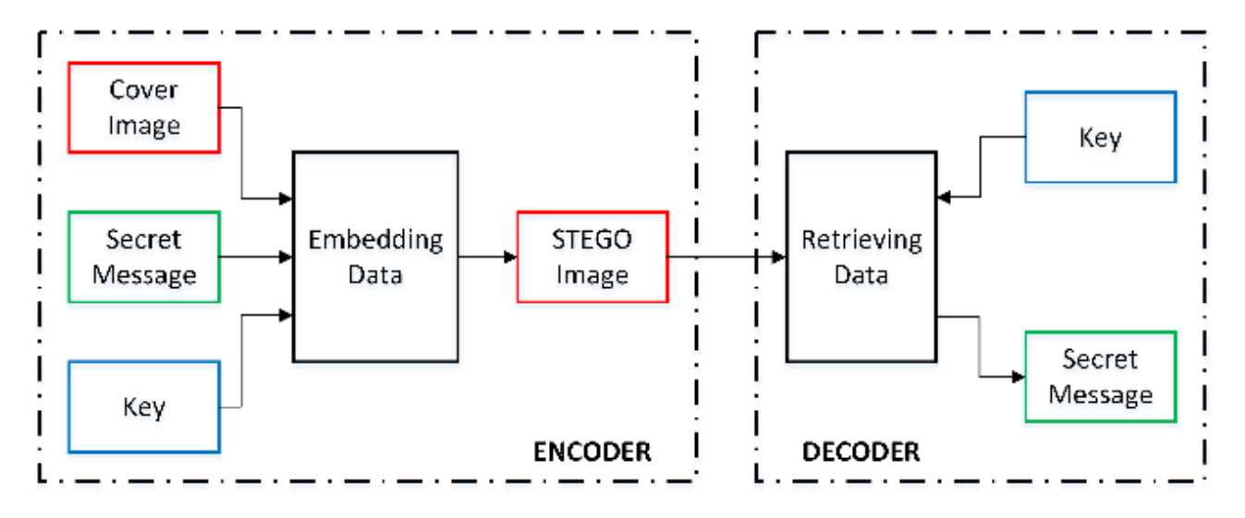
System Architecture

Slide 9
Modules of the Project
Module 1
Module 2
Requirements Gathering
Creating Graphical User Interface
Encoding and Embedding Data
Decoding and Extraction of Data
Module 3
Error Handling and Monitoring
Implementation & Documentation

Slide 10
Description (Modules)
Required Libraries
OpenCV: A library for computer vision, machine learning, and image processing
Pillow: A library for image manipulation and processing
BitArray: A library for efficient arrays of booleans
NumPy: A library for numerical computing with multidimensional arrays and mathematical functions
Scikit-Image: A library for image processing and analysis
Matplotlib: A library for data visualization and plotting
Stegano: A library for steganography, the art of hiding messages in images or other media

Slide 11
LSB Algorithm (Sender Side)
Input Cover & Secret Image
RGB to Grayscale
Divide Images into M*N Matrix
Extract the upper 4-bit planes of secret Image
Extract the 8-bit plane of cover image
Embed the LSB’s of extracted secret image
Embed the MSB’s* of extracted Cover image
Grayscale to RGB
Display Stego Image*
*MSB: Most Significant Bit
*Stego Image: Image in which Secret image is embedded in it

Slide 12
LSB Algorithm (Receiver Side)
Input Stego Image
RGB to Grayscale
Divide Images into M*N matrix
Grayscale to RGB
Perform bit Shift operation to recover secret image
Extract the 8-bit planes of Cover image
Display Extracted Secret Image
*Bit shift is a bitwise operation where the order of several bits is moved, either to the left or right, to efficiently perform a mathematical operation.

Slide 13
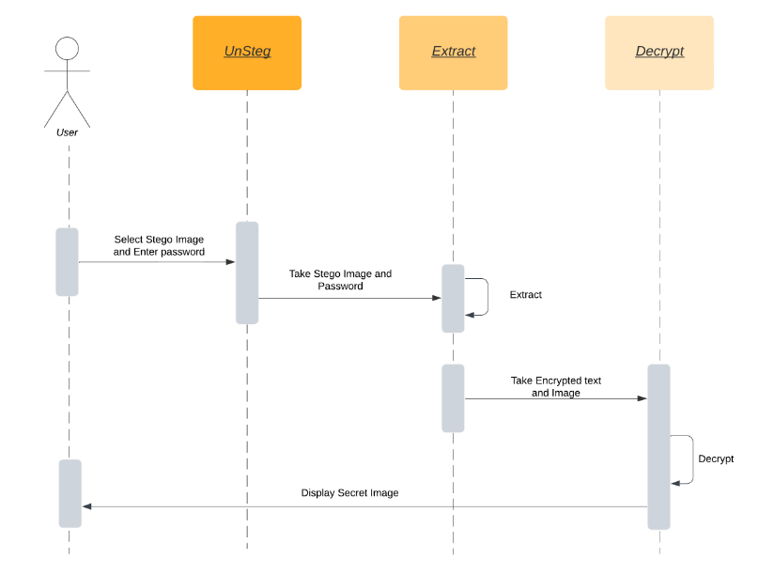
Design of System
Sequence Diagram

Slide 14
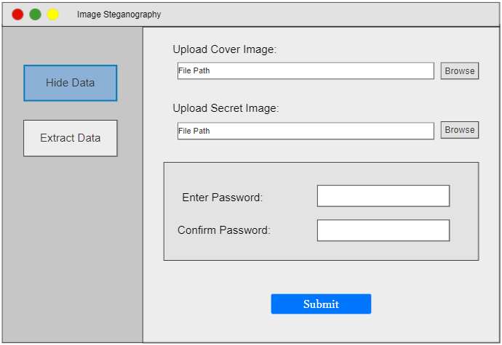
Prototype Model

Slide 15
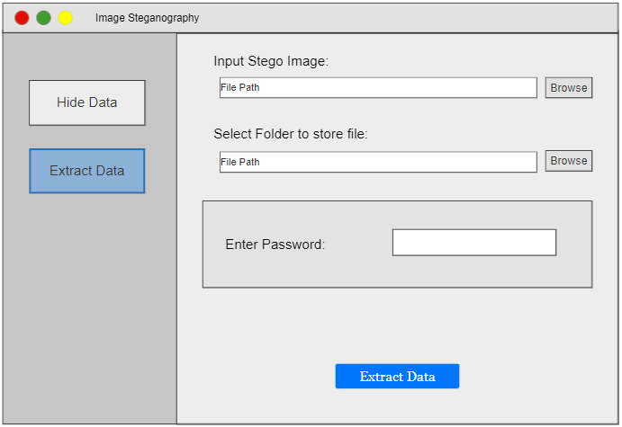
Prototype Model

Slide 16
References
Srushti S Yadahalli, Shambhavi Rege, Dr. Reena Sonkusare “Implementation and analysis of image steganography using Least Significant Bit and Discrete Wavelet Transform techniques”. IEEE Conference Record # 48766; IEEE Xplore ISBN: 978-1-7281-5371-1
Vikas Verma, Poonam, Rishma Chawla “An Enhanced Least Significant Bit Steganography Method Using Midpoint Circle Approach”. International Conference on Communication and Signal Processing, April 3-5, 2014, India
Ako Muhammad Abdullah, Roza Hikmat Hama Aziz “New Approaches to Encrypt and Decrypt Data in Image using Cryptography and Steganography Algorithm”. International Journal of Computer Applications (0975 – 8887)

Slide 17
Thank You.
Group ID: 2305

